Slide 1
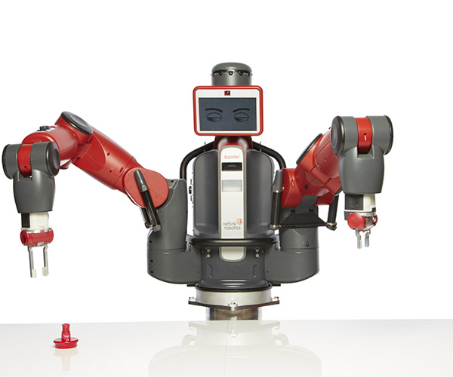
Project 4 : Implementation of Motion Planning on Baxter
Deadline :- April 17th, 11.59 PM

Slide 2
Project 4 Overview
Pick and place of an object avoiding the obstacles on the table using Baxter in simulated environment.
There are two blocks, one on each table. Each block should be picked from its current table and placed safely on the other table, starting with the red block.
May use Gazebo/ Vrep for simulation- Here we provided the instruction for Gazebo (Gazebo/Moveit/Rviz)

Slide 3
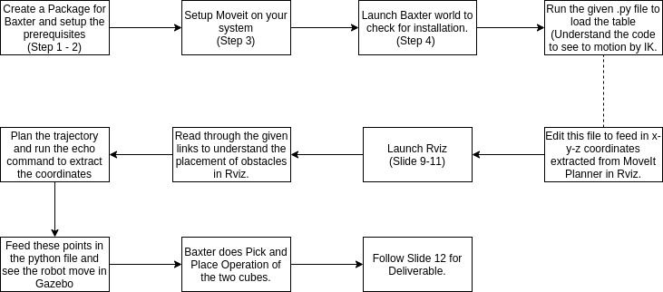
Workflow of the Project

Slide 4
Setup and Execution
Step 1: Create a catkin workspace (Check Session 4 for more details)
Step 2: Follow the link - https://sdk.rethinkrobotics.com/wiki/Simulator_Installation for setup of Baxter simulator
Pre-requisites
Install baxter simulator
Build source
Make changes to baxter.sh (found in /src/baxter) with your version of ROS and IP address. This can be done using an editor such as nano.

Slide 5
Setup and Execution
Step 3: Move-it Setup Run the following commands :
sudo apt-get install ros-kinetic-moveit
To install other packages for move-it Rviz interface :
cd ~/workspace/src
git clone https://github.com/ros-planning/moveit_robots.git
cd ..
catkin_make (to build the recently installed packages in your recently created workspace)
Step 4. Launching Baxter simulator
cd ~/workspace
./baxter.sh sim
roslaunch baxter_gazebo baxter_world.launch

Slide 6
Setup and Execution
Step 5. Executing demo pick and place node
• Open a new terminal
• cd ~/workspace
• source devel/setup.bash
Note: Load the model#.urdf in the respected folder in your workspace.
• rosrun baxter_sim_examples ik_pick_and_place_demo.py
The ik_pick_and_place+demo.py here needs to be edited and the procedure is described in the next slides

Slide 7
What you need to do for Project 4
Edit ik_pick_and_place_demo.py script available in ~/workspace/src/baxter_simulator/baxter_sim_examples
Add way points for the path that you defined
How will you get way points?
You will be using Moveit-Rviz interface to get the waypoints
Rviz is a visualization tool that comes with ROS. It helps you to use Moveit graphically.

Slide 8
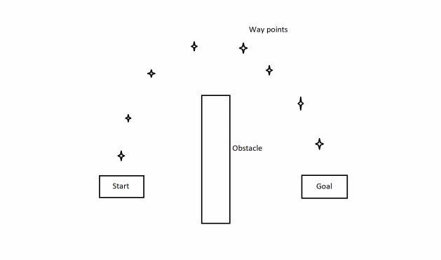
What you need to do for Project 4?

Slide 9
Launching Moveit-Rviz (detailed steps in next slide)
roslaunch baxter_gazebo baxter_world.launch
rosrun baxter_tools enable_robot.py -e
rosrun baxter_interface joint_trajectory_action_server.py
roslaunch baxter_moveit_config demo_baxter.launch right_electric_gripper:=true left_electric_gripper:=true
rostopic echo /robot/limb/left/endpoint_state

Slide 10
Detailed Steps:
Before launching Moveit-Rviz make sure following things are running
roslaunch baxter_gazebo baxter_world.launch
2. Robot is enabled, it can be done using following command (Run in a new terminal)
Open a new terminal
cd workspace
source devel/setup.bash
rosrun baxter_tools enable_robot.py -e

Slide 11
Detailed Steps:
3. Joint trajectory controller is running, use following command (execute in a new terminal window)
cd workspace
source devel/setup.bash
rosrun baxter_interface joint_trajectory_action_server.py
4. Execute following command to launch Moveit-Rviz
cd workspace
source devel/setup.bash
roslaunch baxter_moveit_config demo_baxter.launch right_electric_gripper:=true left_electric_gripper:=true
Note- Path for the obstacle file ros_ws/src/moveit_robots/baxter/baxter_moveit_config/baxter_scenes
You will need to add more obstacles in this file (Please keep in mind the x-y-z coordinate system while adding these blocks)
5. One method to find the x-y-z coordinates of the end effector.
rostopic echo /robot/limb/left/endpoint_state

Slide 12
Deliverables
Screen recording of Gazebo environment from top view covering the pick and place starting from step 4 from setup and execution section.
In the same recording, follow slide 9 to showcase how have you found the trajectory way points from Rviz.
Edited python script – ik_pick_and_place_demo.py
Grade points:
Red Box picked up from the first table to be placed on the second.
White Box picked up from the second table to be placed on first.
MoveIt (Rviz) implementation to check for the trajectory points

Slide 13
Links (Gazebo)
For the simulation (in Gazebo) and implementation on real robot refer
ROS_Presentation & ROS_installation covered in class
http://sdk.rethinkrobotics.com/wiki/Baxter_Simulator
https://sceweb.sce.uhcl.edu/harman/CENG5931Baxter2015/Guides/MoveIt%20work%20with%20Objects3_3_2015.pdf

Slide 14
Links (V-rep)
For the simulation (in V-Rep) and implementation on real robot refer
https://www.youtube.com/watch?v=yUUnHYF9Okw&list=PLugJxt6EeSk_yP61ZI_hmmhWc4JImFiS-&index=5
https://www.youtube.com/watch?v=dst1jVLUaxs&list=PLugJxt6EeSk_yP61ZI_hmmhWc4JImFiS-&index=1
https://www.youtube.com/watch?v=jISDu1tmxdI&index=3&list=PLugJxt6EeSk_yP61ZI_hmmhWc4JImFiS-
https://www.youtube.com/watch?v=aJSTvoHID4k&list=PLugJxt6EeSk_yP61ZI_hmmhWc4JImFiS-&index=4
https://www.youtube.com/watch?v=Zt21o1qsOB4

